Slide 1

Measuring Strain-dependent Surface Stress via Adhesion
The art of sprinkling and stretching
Jeremy K. Thaller
Prof. Katharine E. Jensen

Slide 2
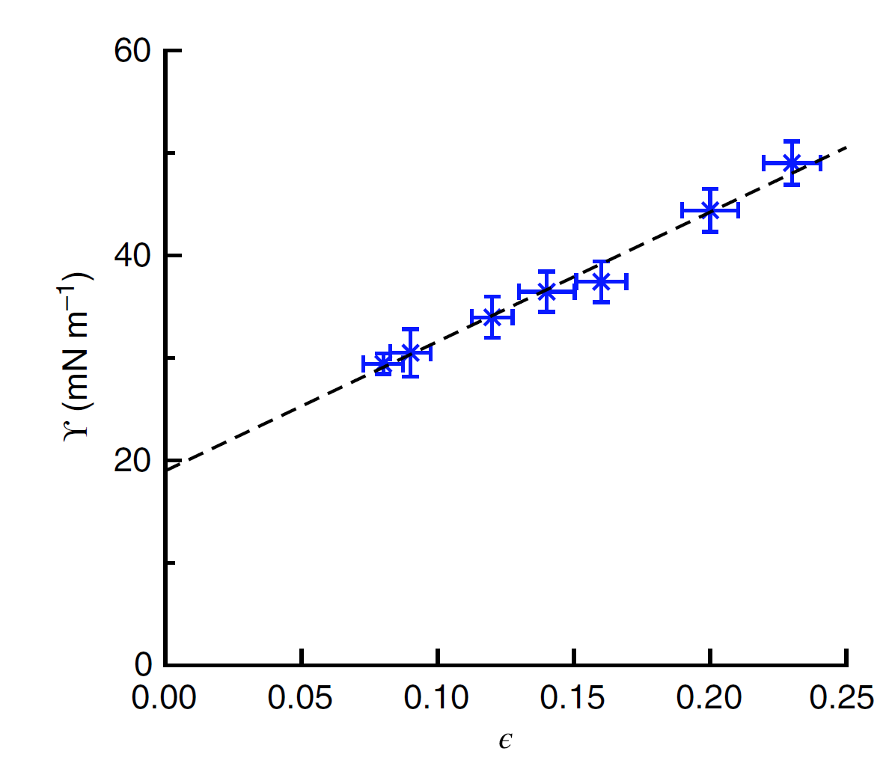
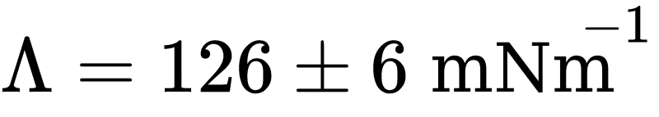
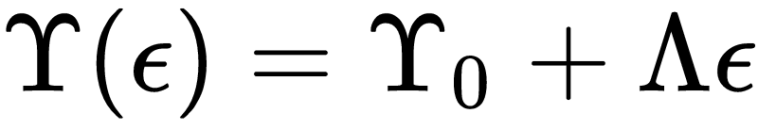
1st Direct Measurement, 2017
Steep Slope!
Xu, Jensen, et al. Nat Comm. (2017)
Notes:
Note to self to KEJ. What was \Lamda, surface Modulus again? But what really is that? And How does it relate to adhesion energy, W, etc. defining it as the slop of this curve as its definition seems silly, considering this was the first direct measurment of it….

Slide 3
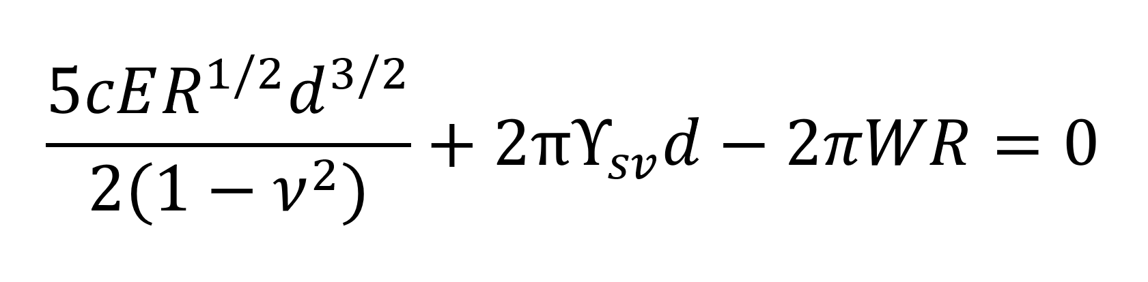
Our Approach: Elastocapillary Adhesion
Adhesion tries to make increase contact area
But… requires the bulk to stretch and the surface to stretch.
Elasticity resists the stretching of the bulk.
Surface stress resists the stretching of the surface.
Style et al. Nat. Comm. (2013)
Notes:
Interplay of elasticity and surface stress:
Balance the forces. Take derivative = 0 (b/c rhs is a constant).
1 cap
⅓ elast
There’s been a lot of work in the last several years exploring the impact of surace stresss on the mechanics of soft solids. We want to take advantage of whats now known about hte role of surface stresss in soft adhesion to directly measure the surface stress as we change the underlying substrate.
This force balance equation contains elements that we can measure seperately, such as the Young’s Modulus and the poisson ratio, as well as terms we can measure directly on our sphere laiden substrate.

Slide 4
Use confocal microscopy to measure 3D surface deformations
Soft Substrate
Coat the substrate with fluorescent beads ~ 40nm

Slide 5
Use confocal microscopy to measure 3D surface deformations
Soft Substrate
Sprinkle Silica Spheres (R = 5 - 50 microns)

Slide 6

Use confocal microscopy to measure 3D surface deformations
confocal
slices

Slide 7
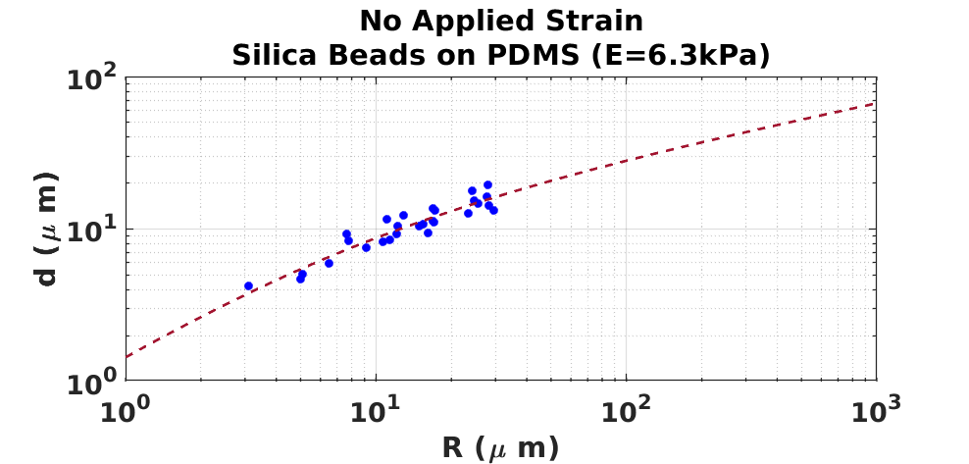
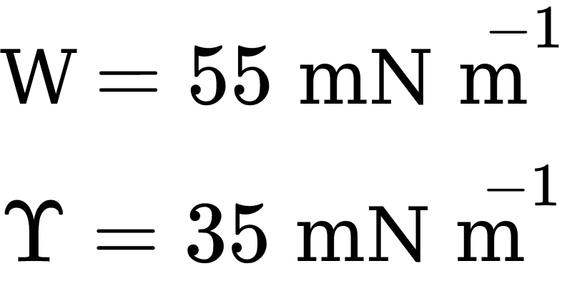
Notes:
Add title. No applied Strain
mN/m
33 52
E = 5.9 Remove G9:1

Slide 8
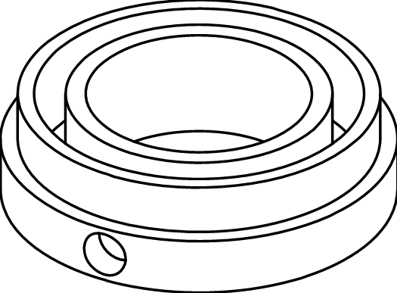
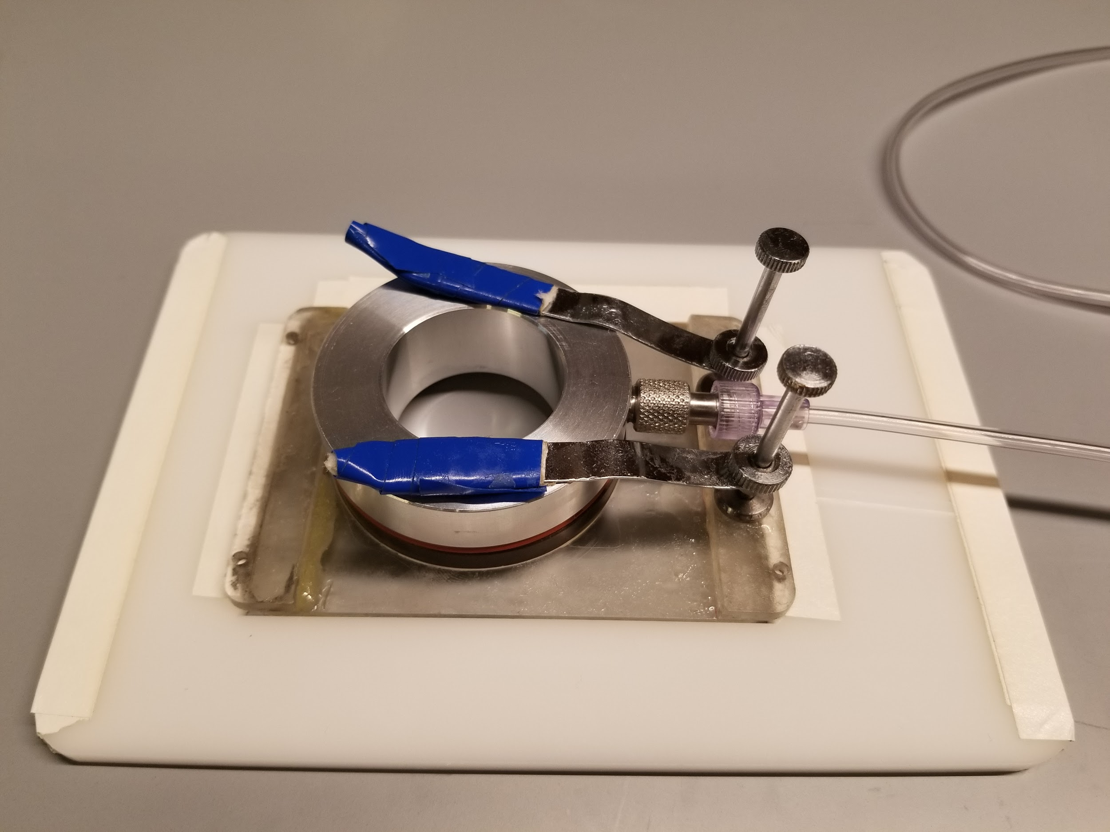
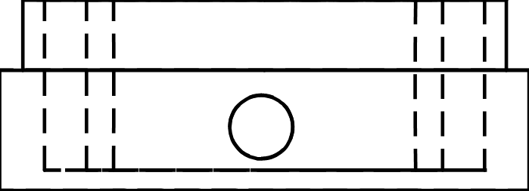
Equibiaxial Stretching Apparatus
Design based on Na, S. et al Ann. Biomed. Eng. (2008) and Modified from Qin, Jensen et al. Nat. Comm. (2017)
Notes:
Controlled geometry stretcher
Pass around stretchy boi with syringe. Draw bear face on it.

Slide 9
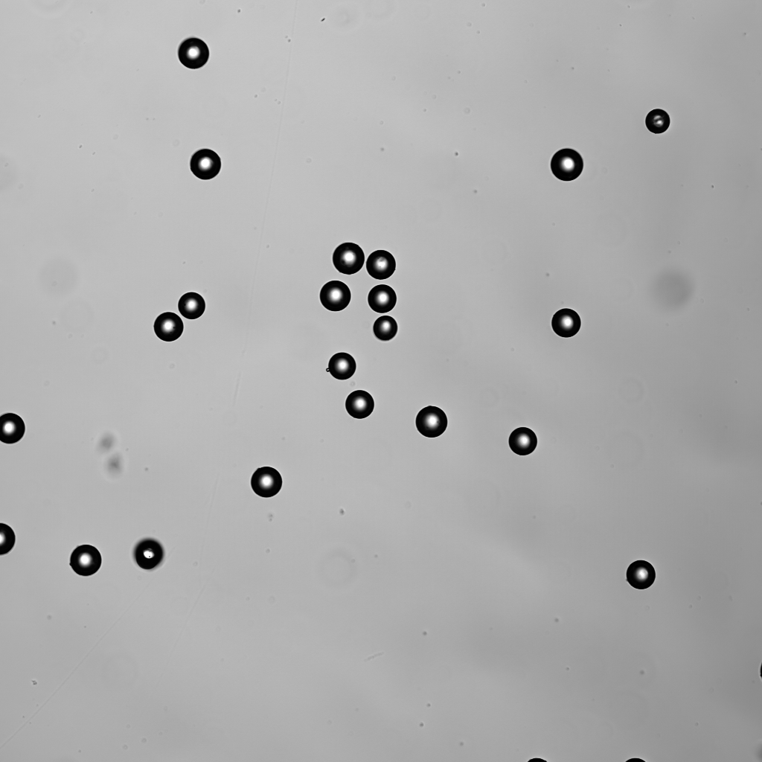
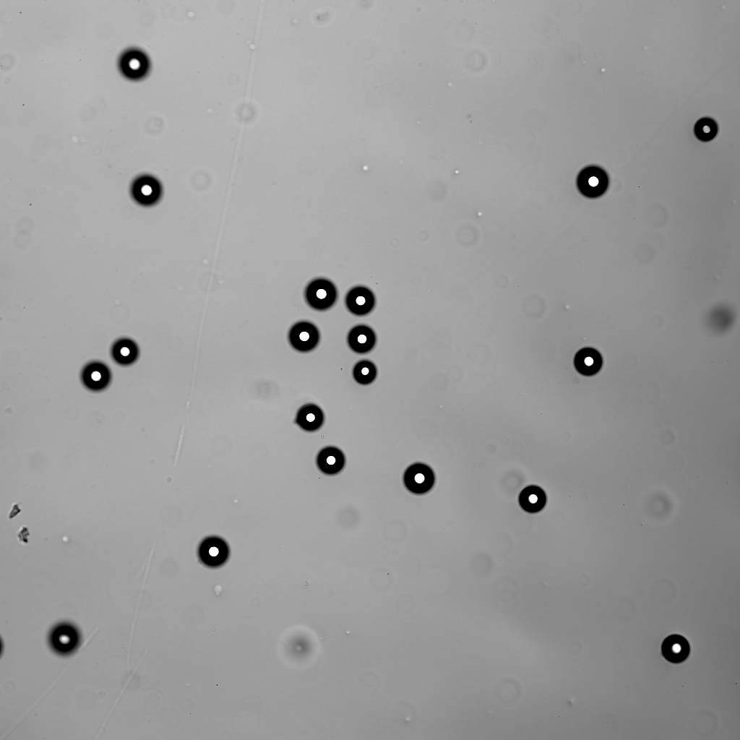
Brightfield 10x zoom
Before stretch
After stretch: 13ml Pull

Slide 10
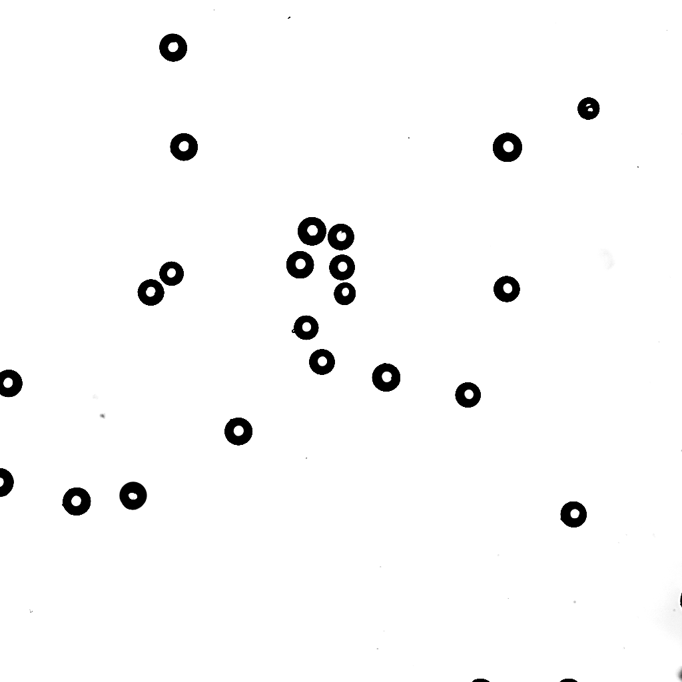
Before and After Stretch Overlay
Dark spheres are after stretch

Slide 11
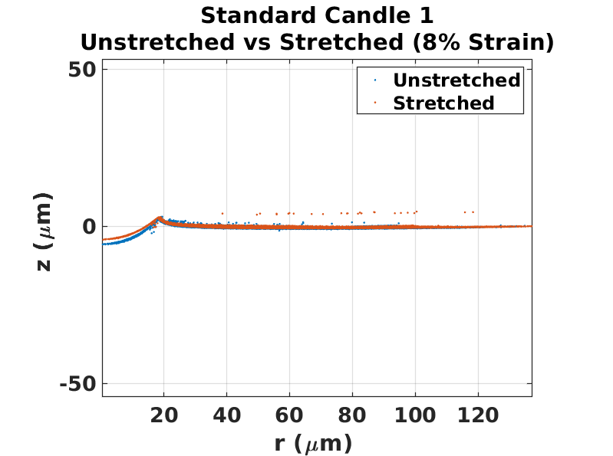

Slide 12
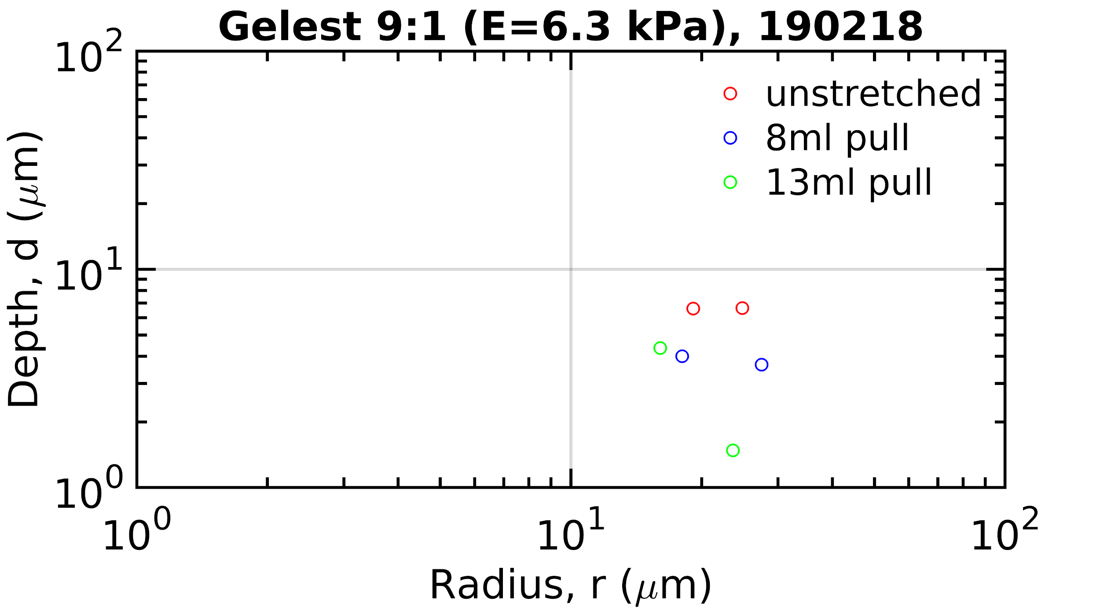
“Standard Candles”

Slide 13
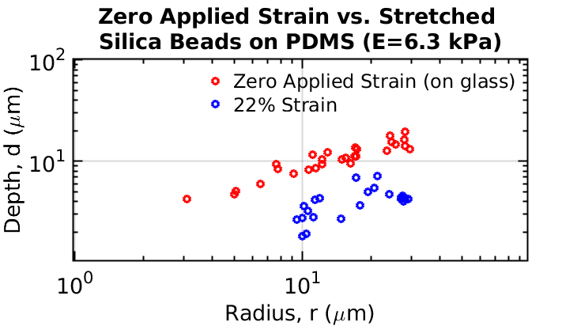

Slide 14
Summary and Outlook
So far...
Promising results for measuring W and ϒ for unstretched Materials
Still trouble shooting the noise in stretched data.
And then...
Measure ϒ(ε) and W(ε) in a variety of soft solids.
Notes:
E did bulk tensile that shows that the material is linear elastic up to about 25% true strain. After that we start to see slight strain-stiffening.

Slide 15
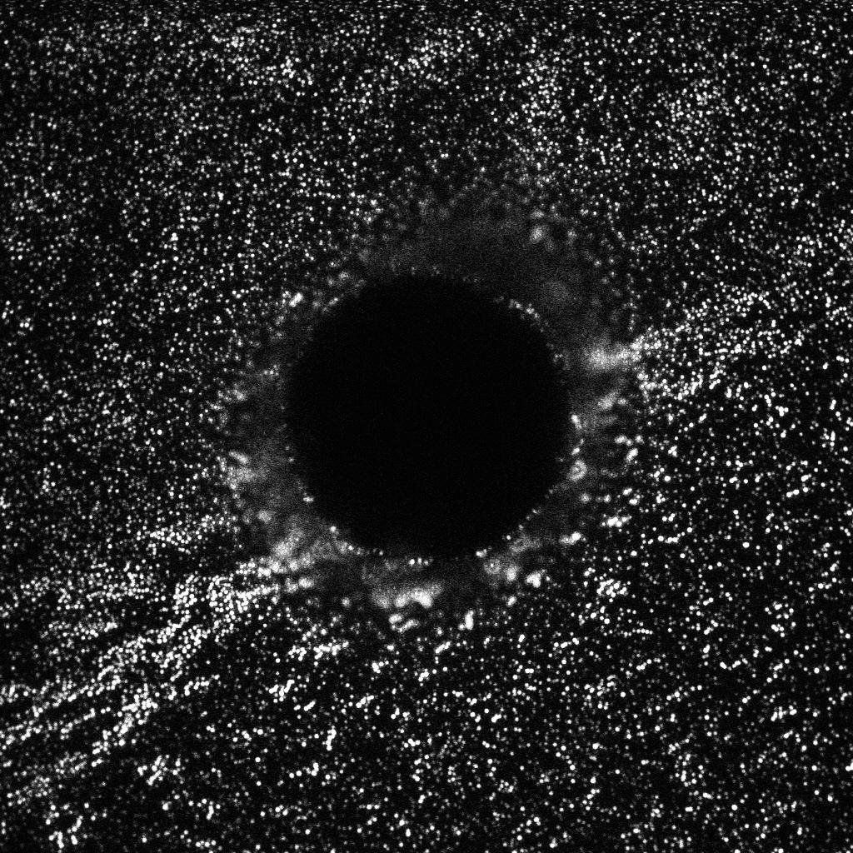
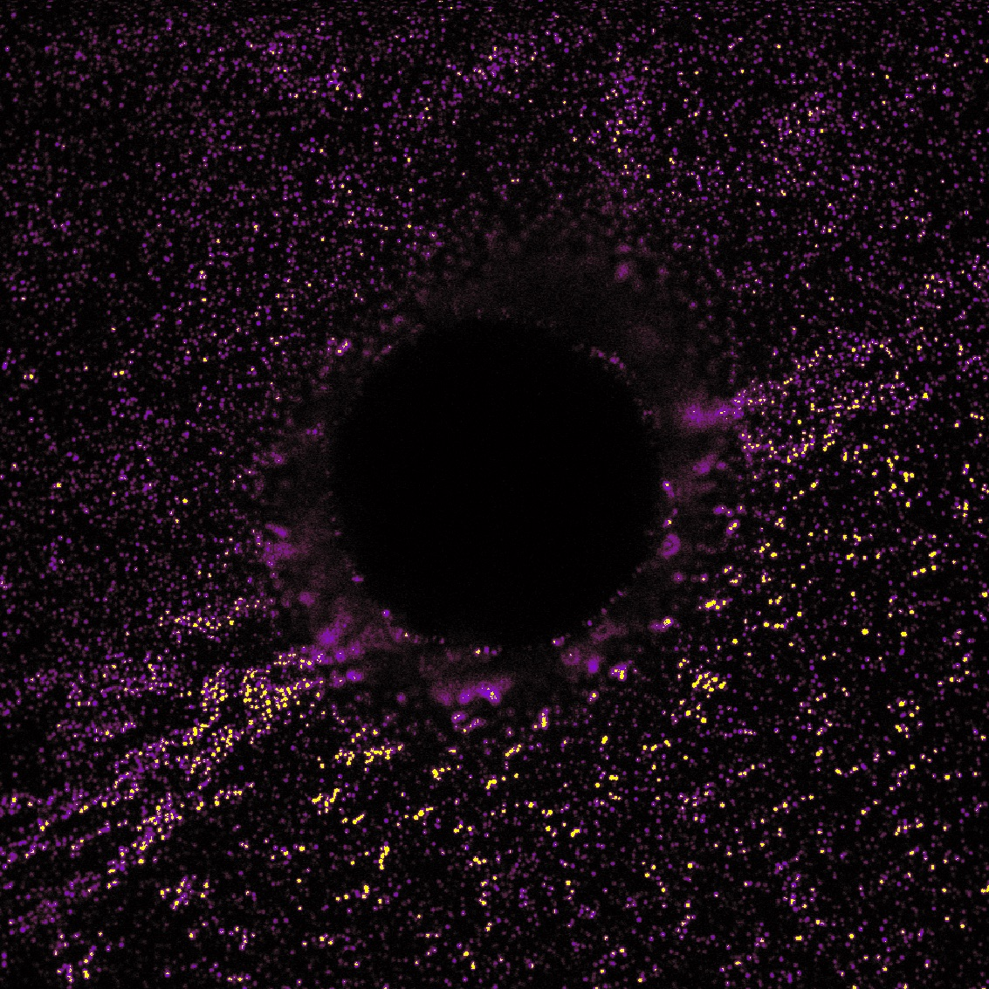
Questions?
Notes:
Here is your image
Ok back to typing at you now

Slide 16

The Plan
Step 1:
Choose gel

Slide 17

The Plan
Step 2: Sprinkle
The spheres need to be small enough so that we are in the elastocapillary physics regime

Slide 18
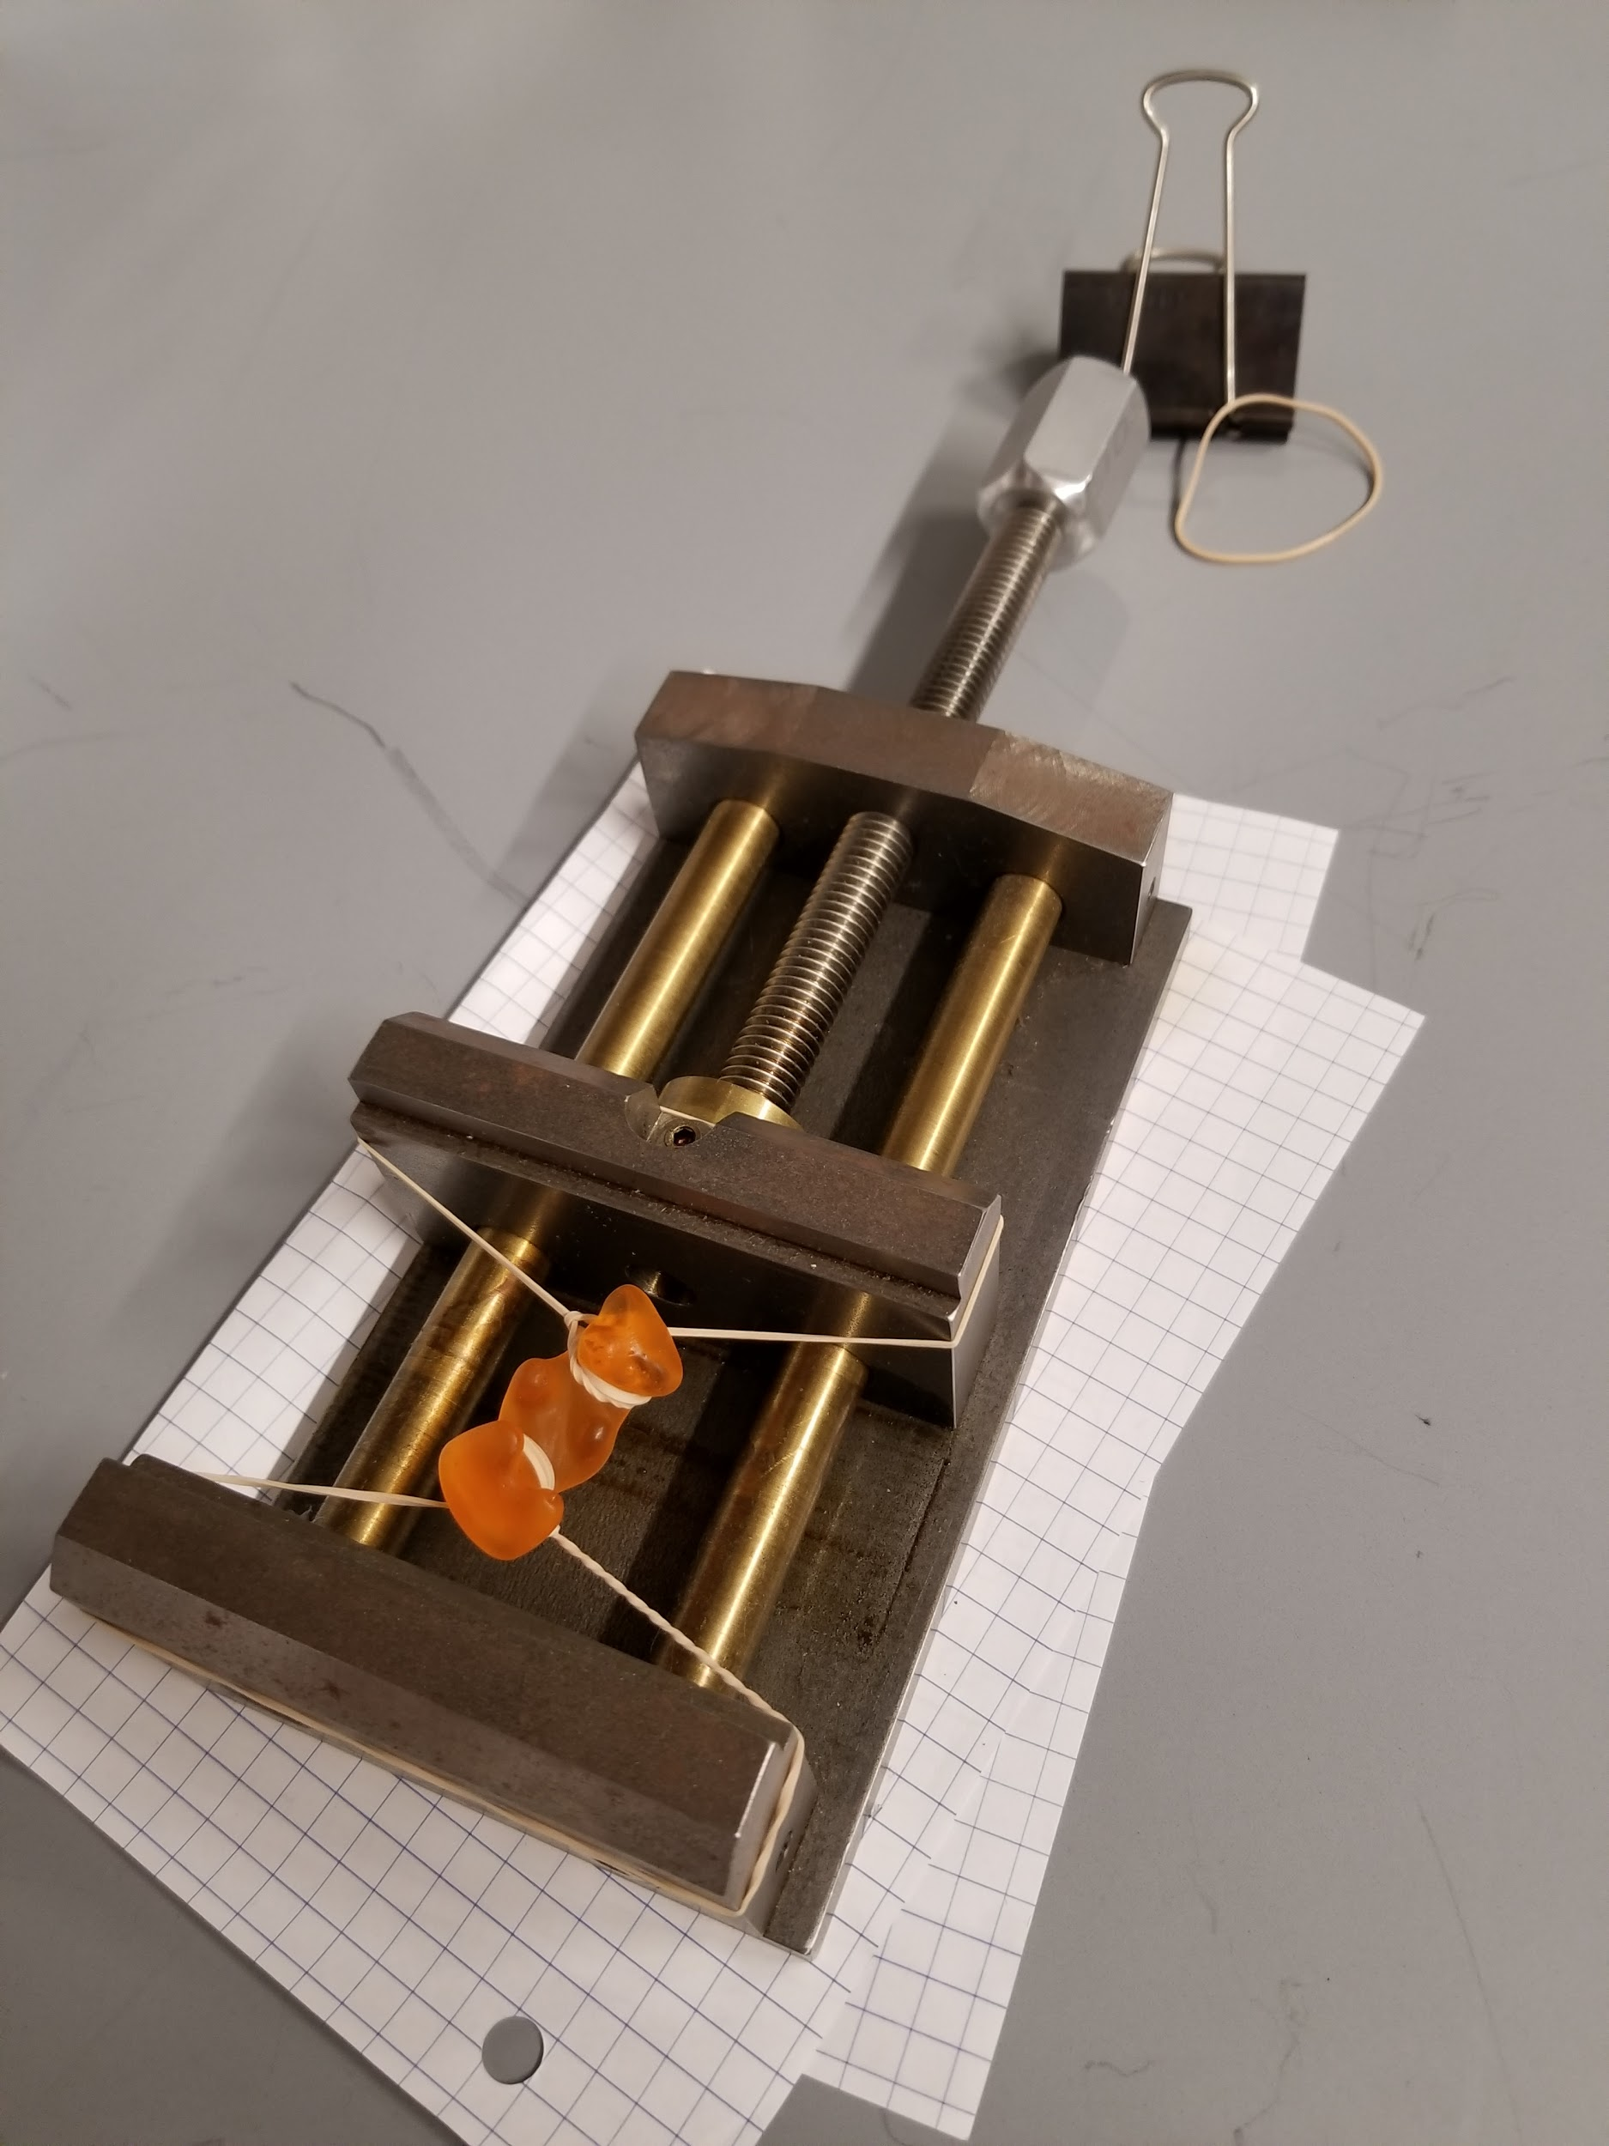
The Plan
Step 3: Stretch it
Make better stretcher picture
The elasticity and surface stress pull back.

Slide 19
The Plan
Step 3: Stretch it
Make better stretcher picture
The elasticity and surface stress pull back.

Slide 20
The Plan
Step 4: Profit Measure d vs r
Do the spheres still sink in as deep as before?
Learn how adhesion changes and what is doing what
r = radius of sphere
d = depth of sinkage
Das Gummibärli

Slide 21
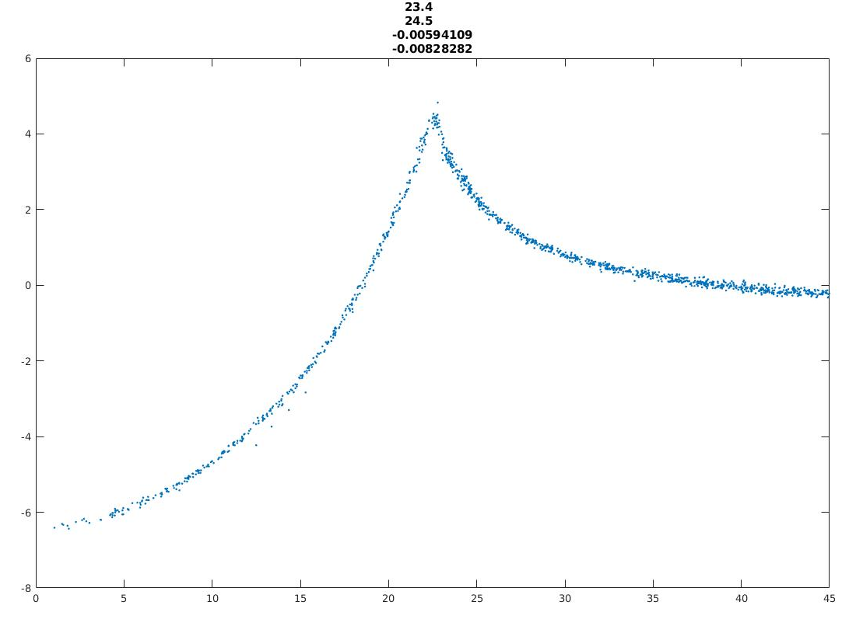
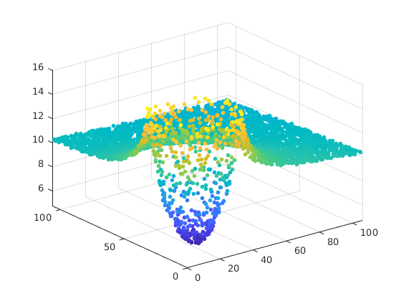
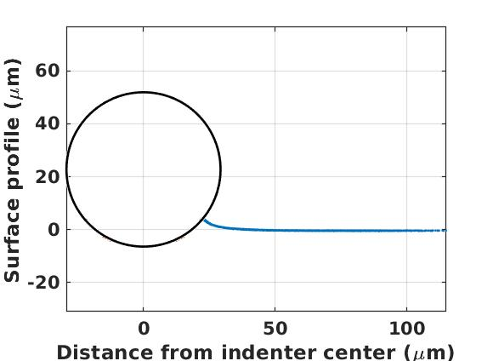
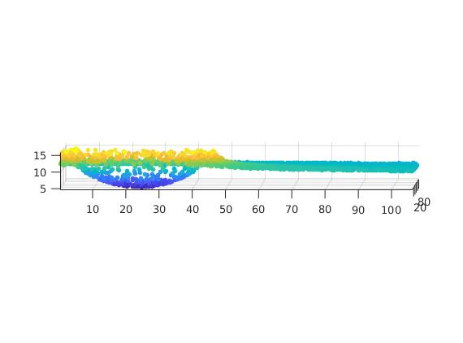
Preliminary Data
Side Profile: Left indent is sphere pulling up substrate
Circle fit side profile to find size of sphere.
From Sphere 17: 15.11.18

Slide 22
Outlook: What’s next?
More data soon! Measure d vs. r at different strains.
Fit for the parameters - Solve for surface stress values and W (adhesion energy)
Profit. Write paper.
How about real world applications? Make Theory claim? Test other gels to show it’s a universal property?
Measure strain dependent surface stretch in cats?

Slide 23
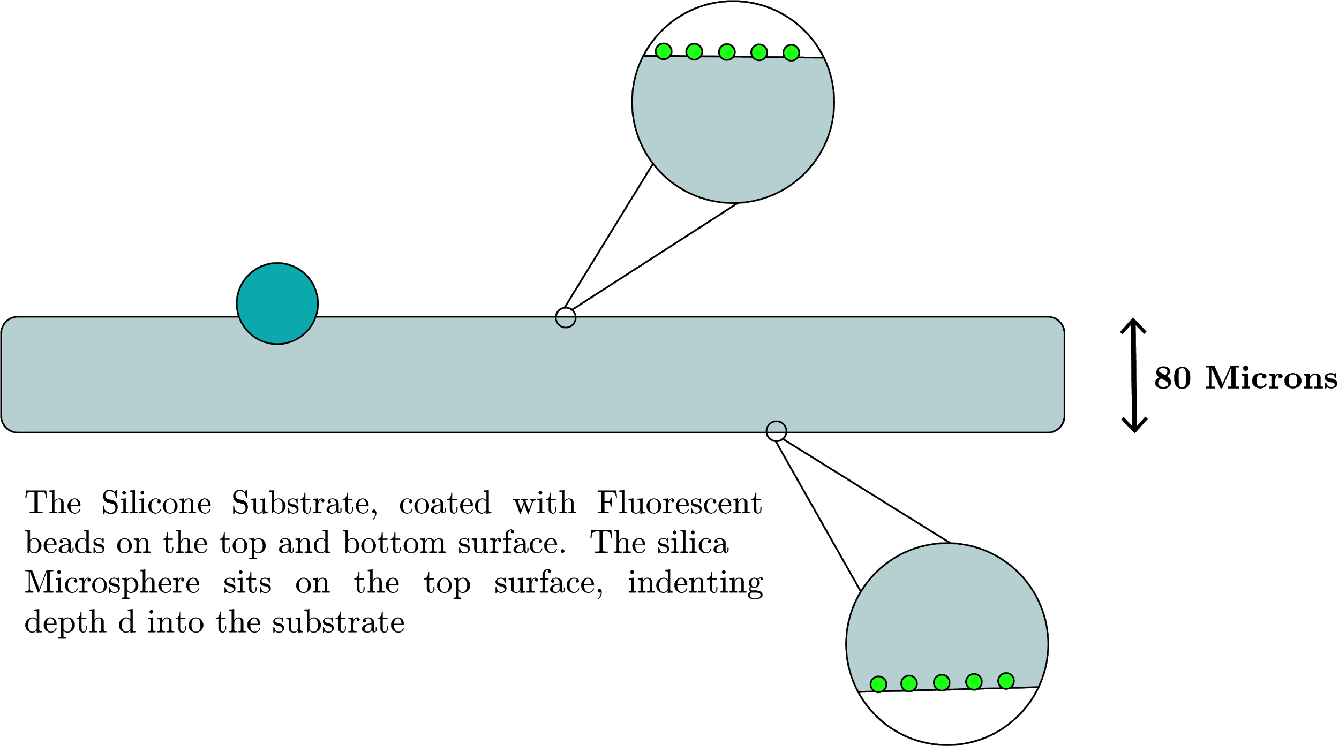
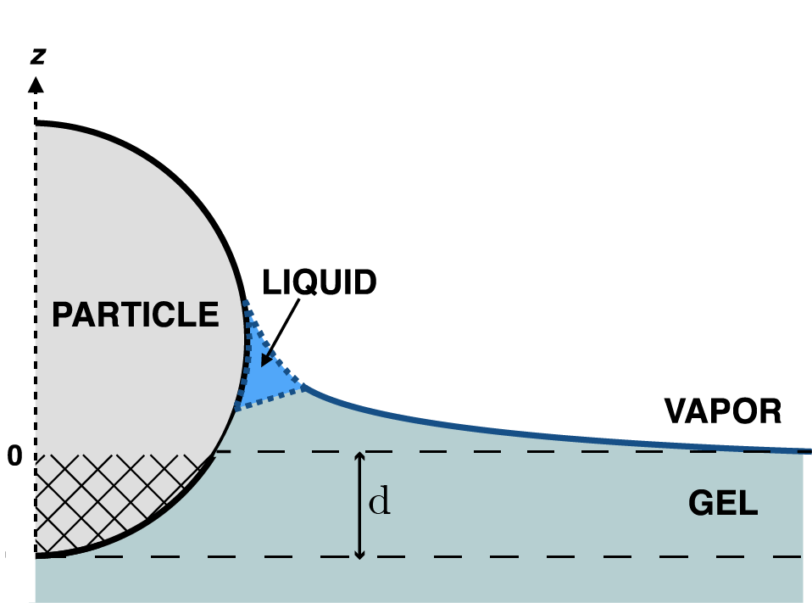
The setup
Silica microsphere diameter ~ 25 microns
Fluorescent Bead diameter ~ 40nm

Slide 24
Use confocal microscopy to measure 3D surface deformations
confocal
slices

Slide 25
Use confocal microscopy to measure 3D surface deformations
Silica sphere ~ 30 microns
Coat the substrate with fluorescent beads ~ 40nm

Slide 26

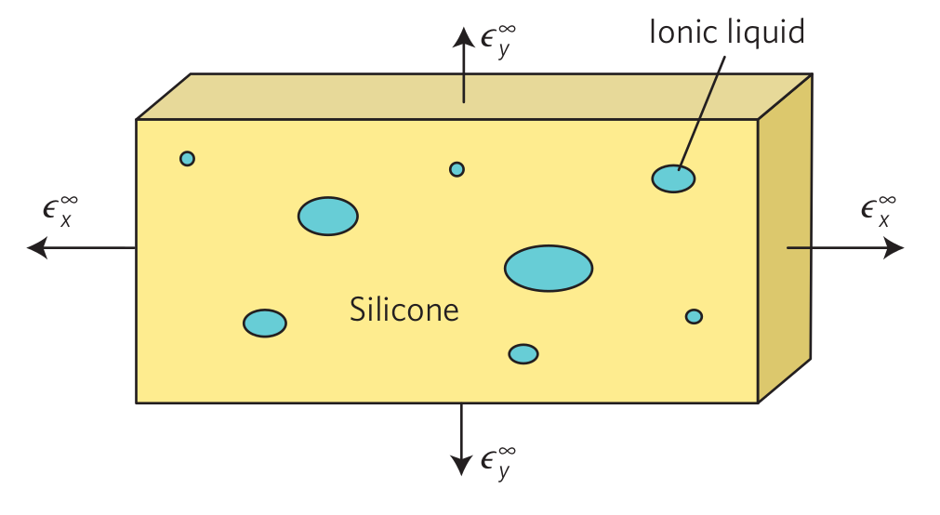
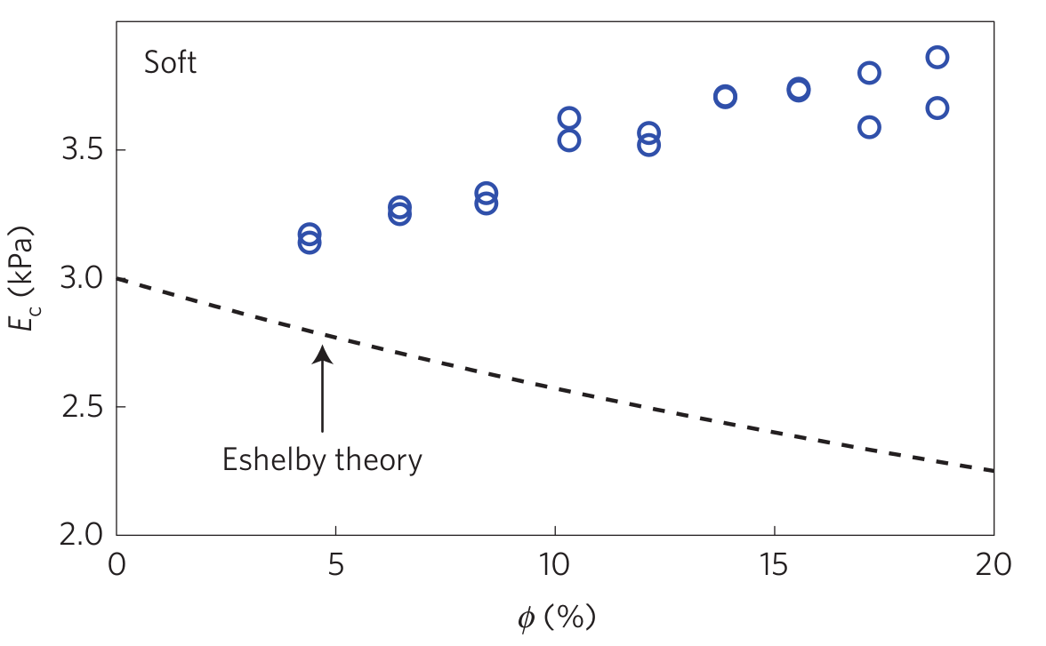
Solids have surface stress too
… but It’s small compared to the elasticity of the bulk
Notes:
Solids have surface tension (surface stress) too. The elasticity of the bulk is a much stronger force (?) compared to the surface tension (for metals and things)
Surface area to bulk …. And soft materials where elastic stiffness is low ….. Leads to weird physics
Soft Matter:
In soft matter, surface stress can compete and even dominate over elasticity. (Think about the elasticity of something like water vs a metal. Much easier to “stretch” a liquid. Small elastic forces).
Might cut this slide because of time
The addition of holes adds surface area. Surface stress tries to resist deformation because …. Surface stress dominates of elasticity at this regime. Takes energy to create new surface while stretching. More opportunities for this now because there is more surface area. Surface stress dominates over elasticity in this regime.

